Slide 1
HeadsUP
Optical Mobility Aid
Austin Singh (P.S.E.)
Hunter Tanchin (Cp.E.)
Alex Radulescu (E.E.)
Duc-Quy Nguyen (P.S.E.)
Notes:
Quy

Slide 2

The Problem
STOP

Slide 3
Motivation and Goals
STOP
Notes:
Extending Range of Awareness and Detect Mid Level Objects Chest or above waist high

Slide 4
Specifications
Detection Distance | 0.5 meters ≤ D ≤ 2 meters
Operational Lifetime | 24 Hours
Processing Speed | 250 ms
Distance Resolution | 20 cm
Notes:
Reflex Time

Slide 5
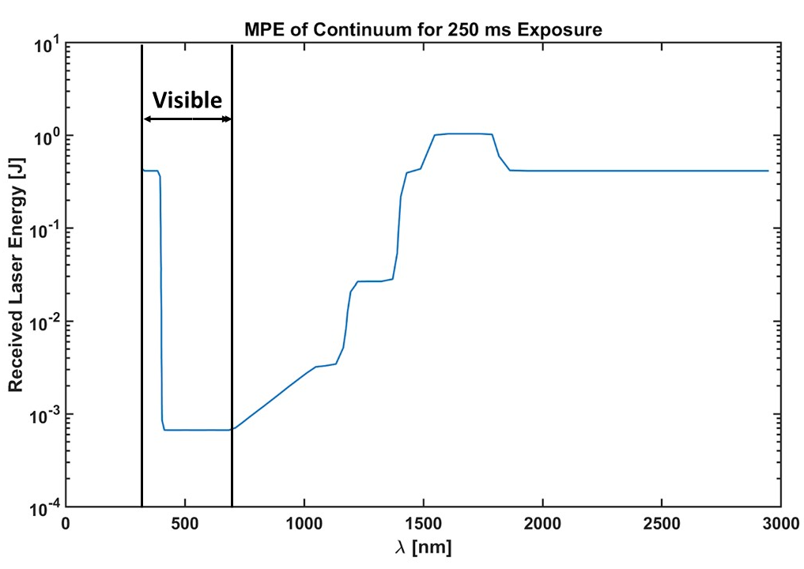
Constraints & Standards
Size | 9 cm x 15 cm Area
Weight | < 2.5 kg
Eye-Safe | MPE = 100 ms 𝜆 = 905 nm P_{out} = 3.2 mW
Laser Eye Safety Standard IEC 60825
Notes:
Austin, this graphic will be referenced later on component selection of laser diode, Talk higher up on y axis the safer it goes

Slide 6
Working Principle

Slide 7
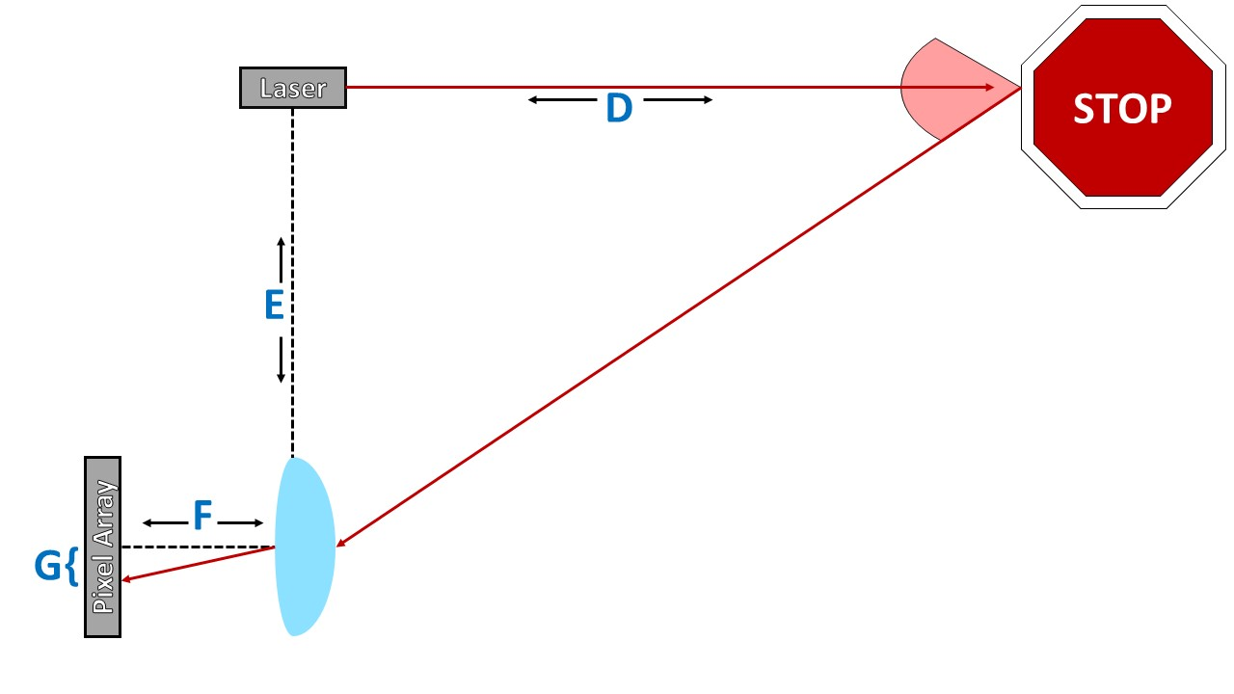
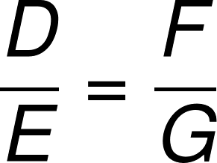
Laser Triangulation Principle
Notes:
E = 12 cm, F = 1.5 cm, G = 0-2.9 cm, thus giving a minimum D of 40 cm, maximum D theoretically infinity. Depth of Field and Depth of Focus affect our viewing distance though, as well as abberations.

Slide 8
Hardware

Slide 9
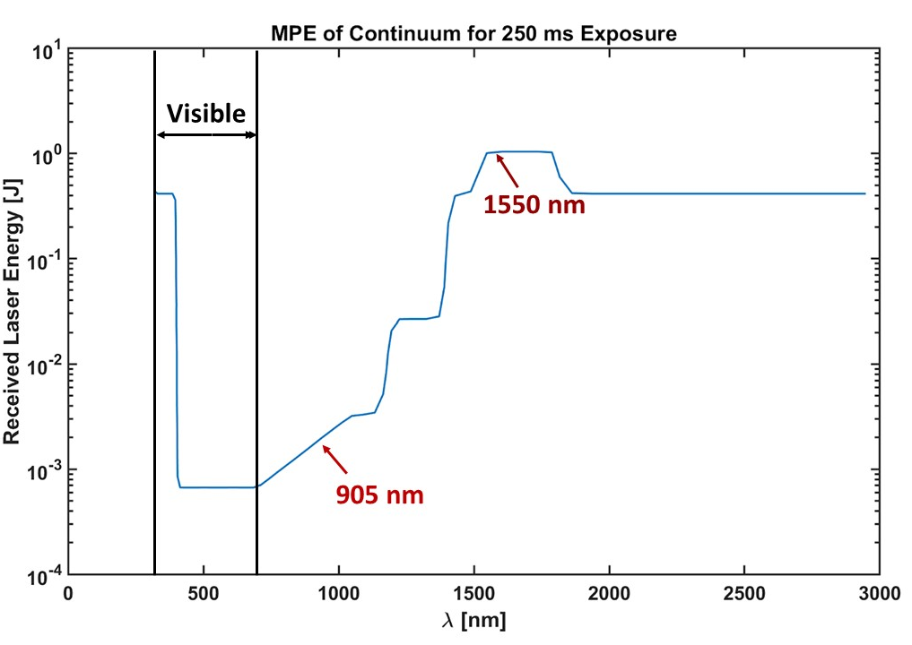
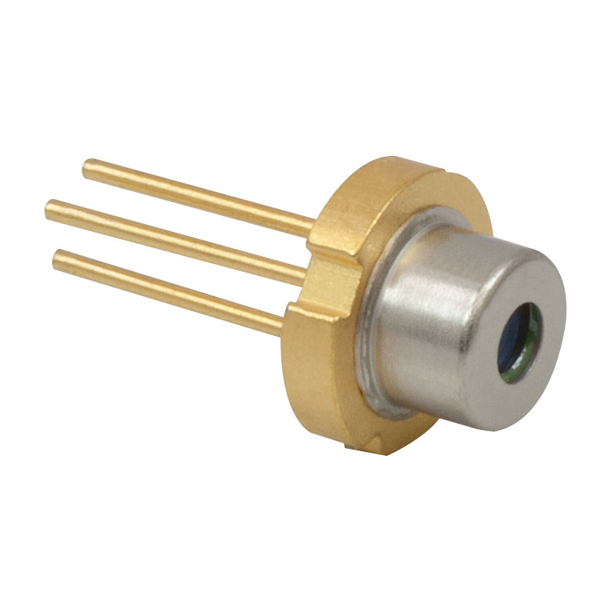
Laser Transmitter
Thorlabs L904P010 Laser Diode
λ = 904 nm
P_{out} = 10 mW
MPE
Notes:
Explain RGB sensitivity of eye, cost aspect, focusing off the retina, higher MPE is better, all for Class I

Slide 10
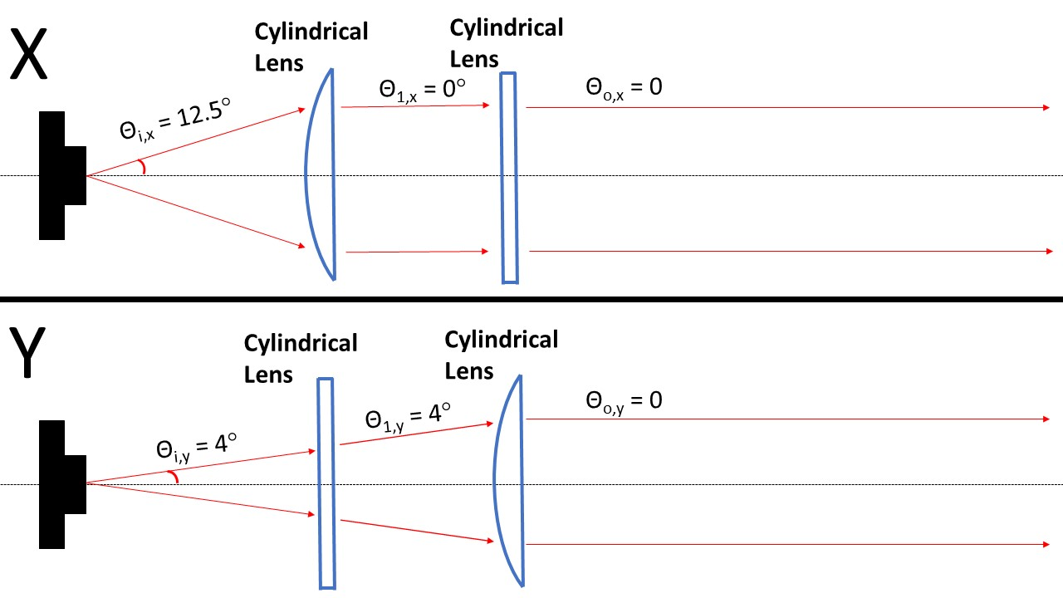
Collimation Optics

Slide 11
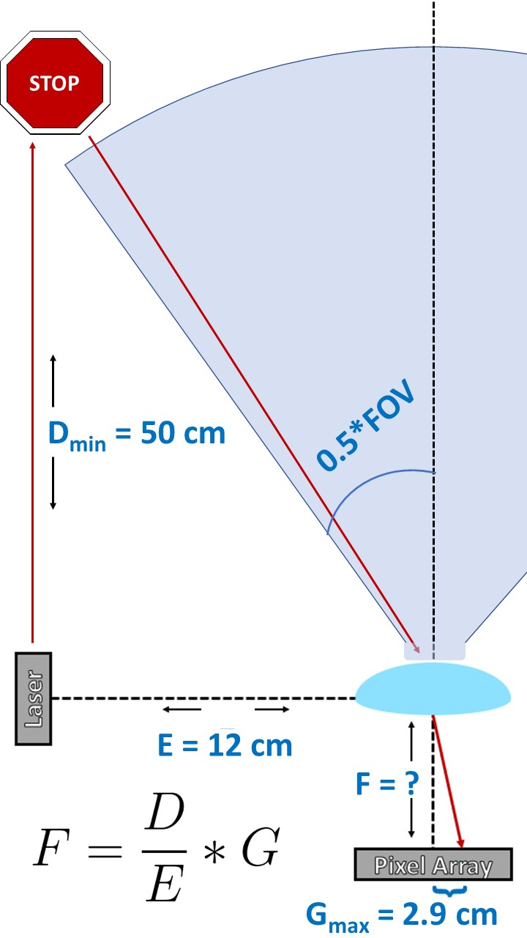
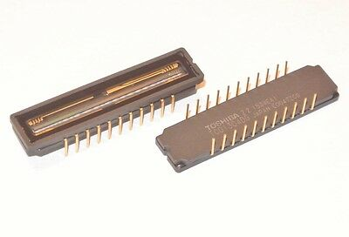
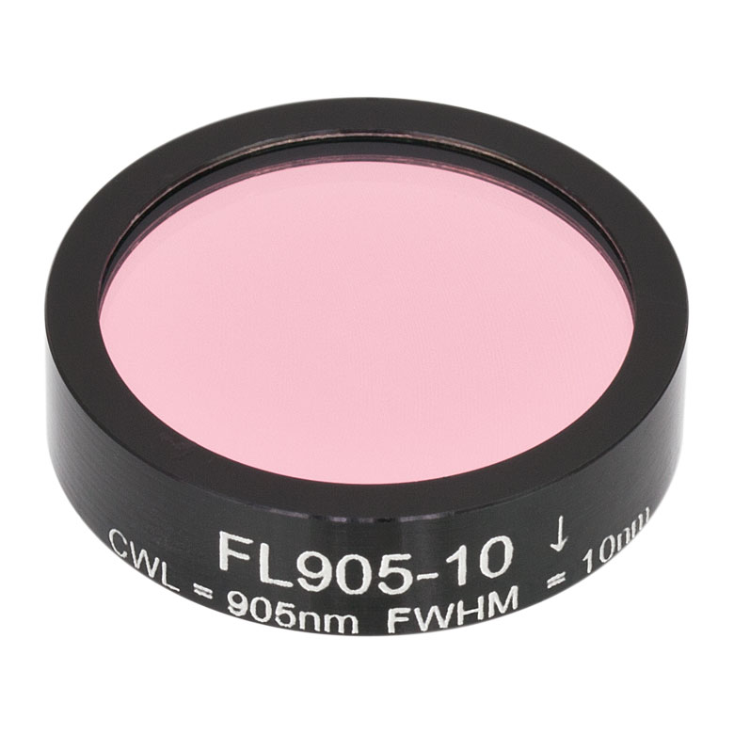
Imaging System
Toshiba TCD1304DG Linear CCD Image Sensor
Thorlabs FL905-10 Bandpass Filter
S = 32 V/lx*s
29 mm Active Area
Notes:
Field of View, Depth of Field, Bandpass Filter

Slide 12
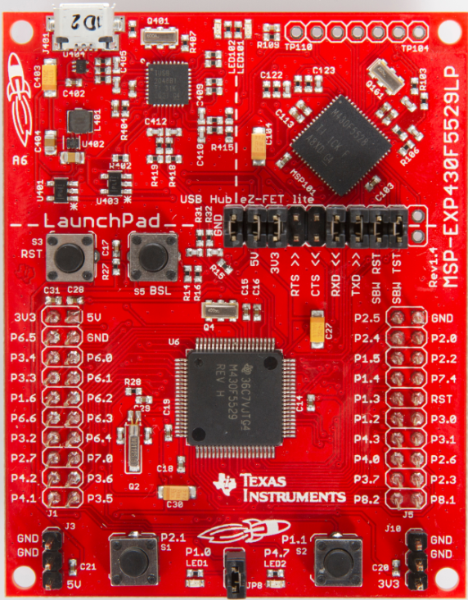
Microcontroller - MSP430F6459
Up to 32 MHz
12-bit Analog-to-Digital Converters
Direct Memory Access Channels
Low-Power Modes
512 kb FLASH
66 kb RAM
Past MSP430 Experience
Notes:
Hunter

Slide 13
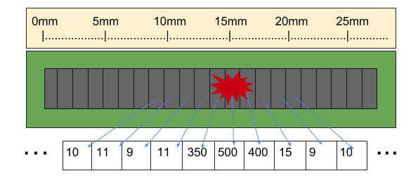
Computational Logic
IMAGE SENSOR
Notes:
Intensity values let us know where the beam is spatially --> using spatial information to let you know how far away something is, correlate distance

Slide 14
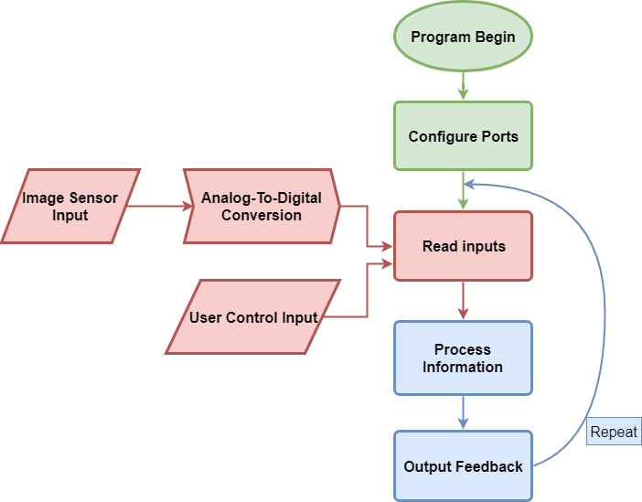
Software Flow

Slide 15
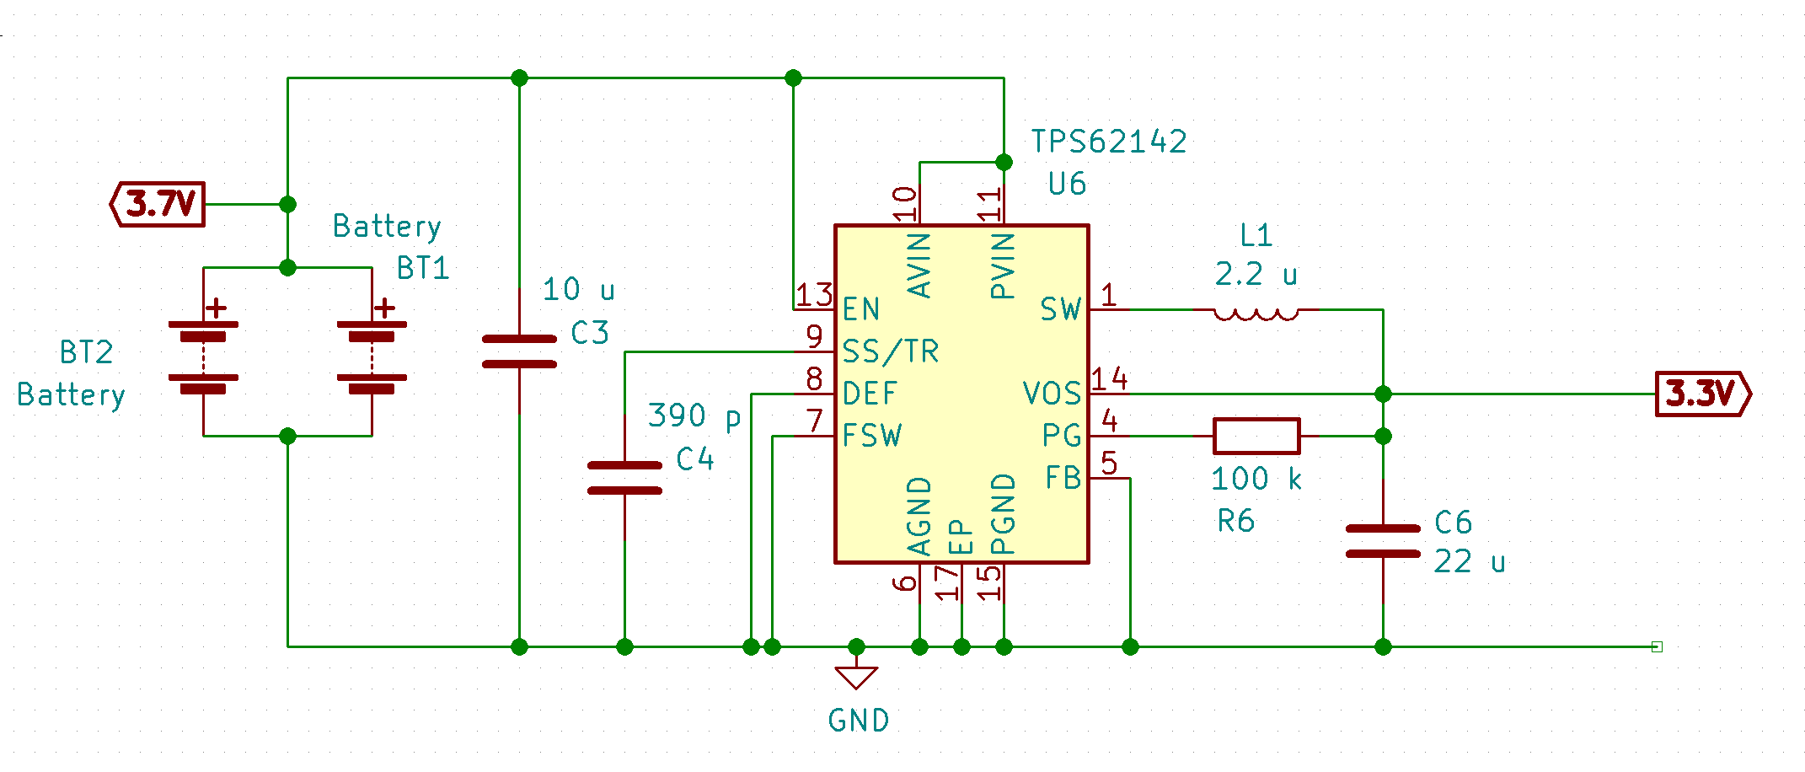
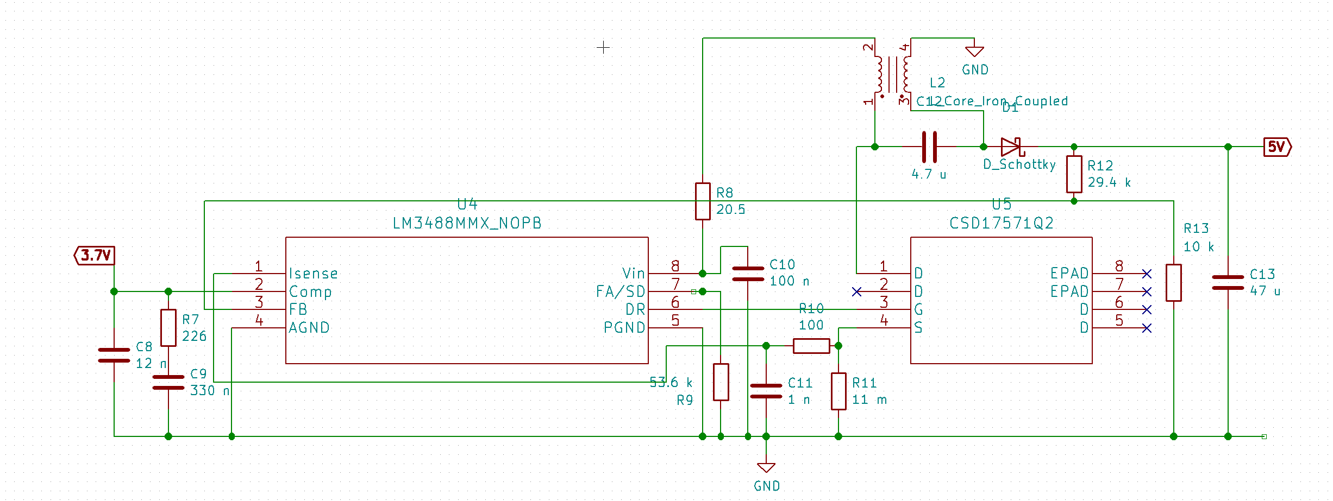
Power
Batteries
  Two 3.7V and 2700mAh Li-Ion batteries in parallel
Voltage regulation
  3.7V to 3.3V step-down
  3.7V to 5V step-up
Notes:
Alex, talk battery first then talka bout step up and step down voltagges

Slide 16
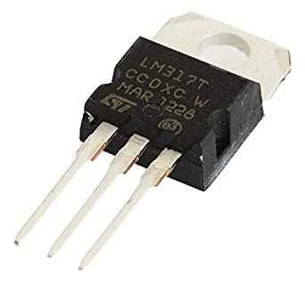
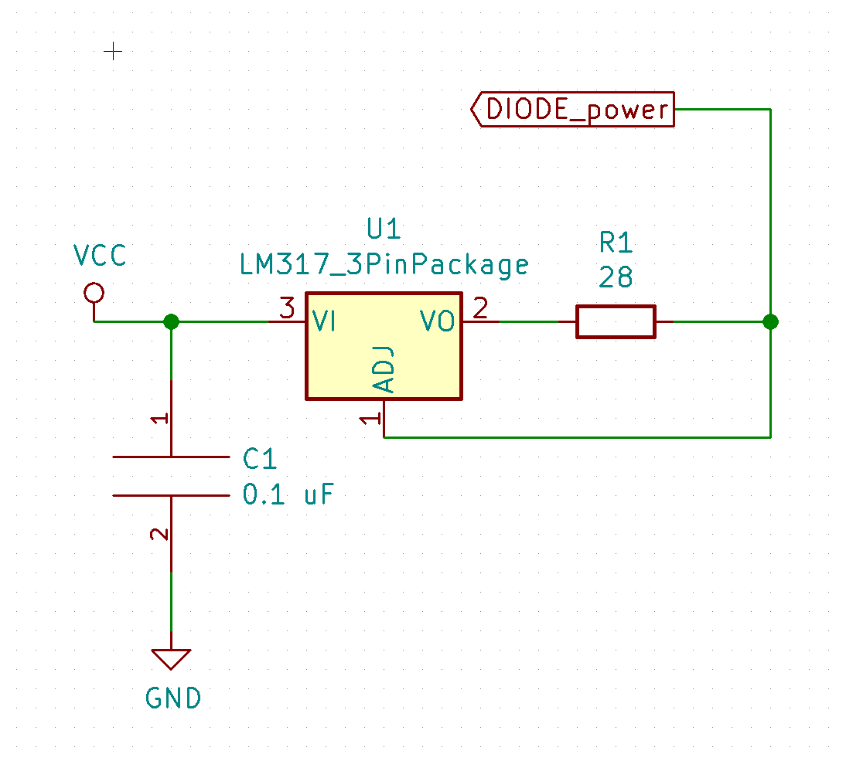
Laser Diode Driver (LM317)
Notes:
Include diagrams for LM317 and TCD1304DG

Slide 17
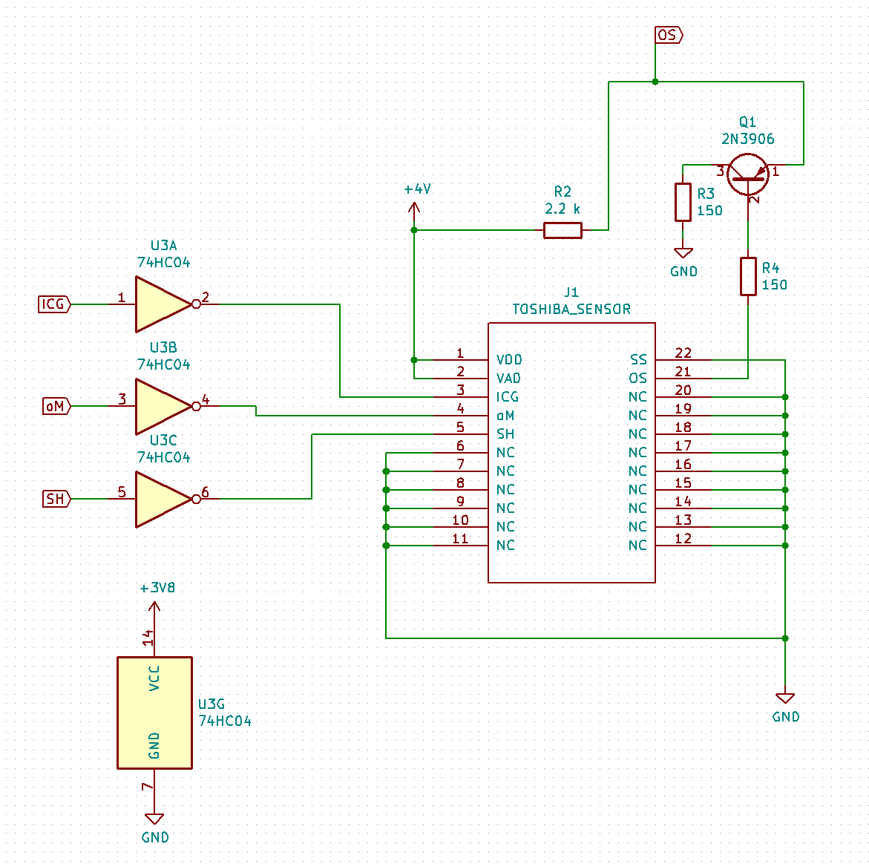
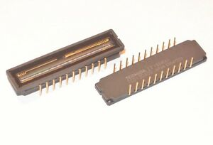
Image Sensor (Toshiba TCD1304DG)

Slide 18
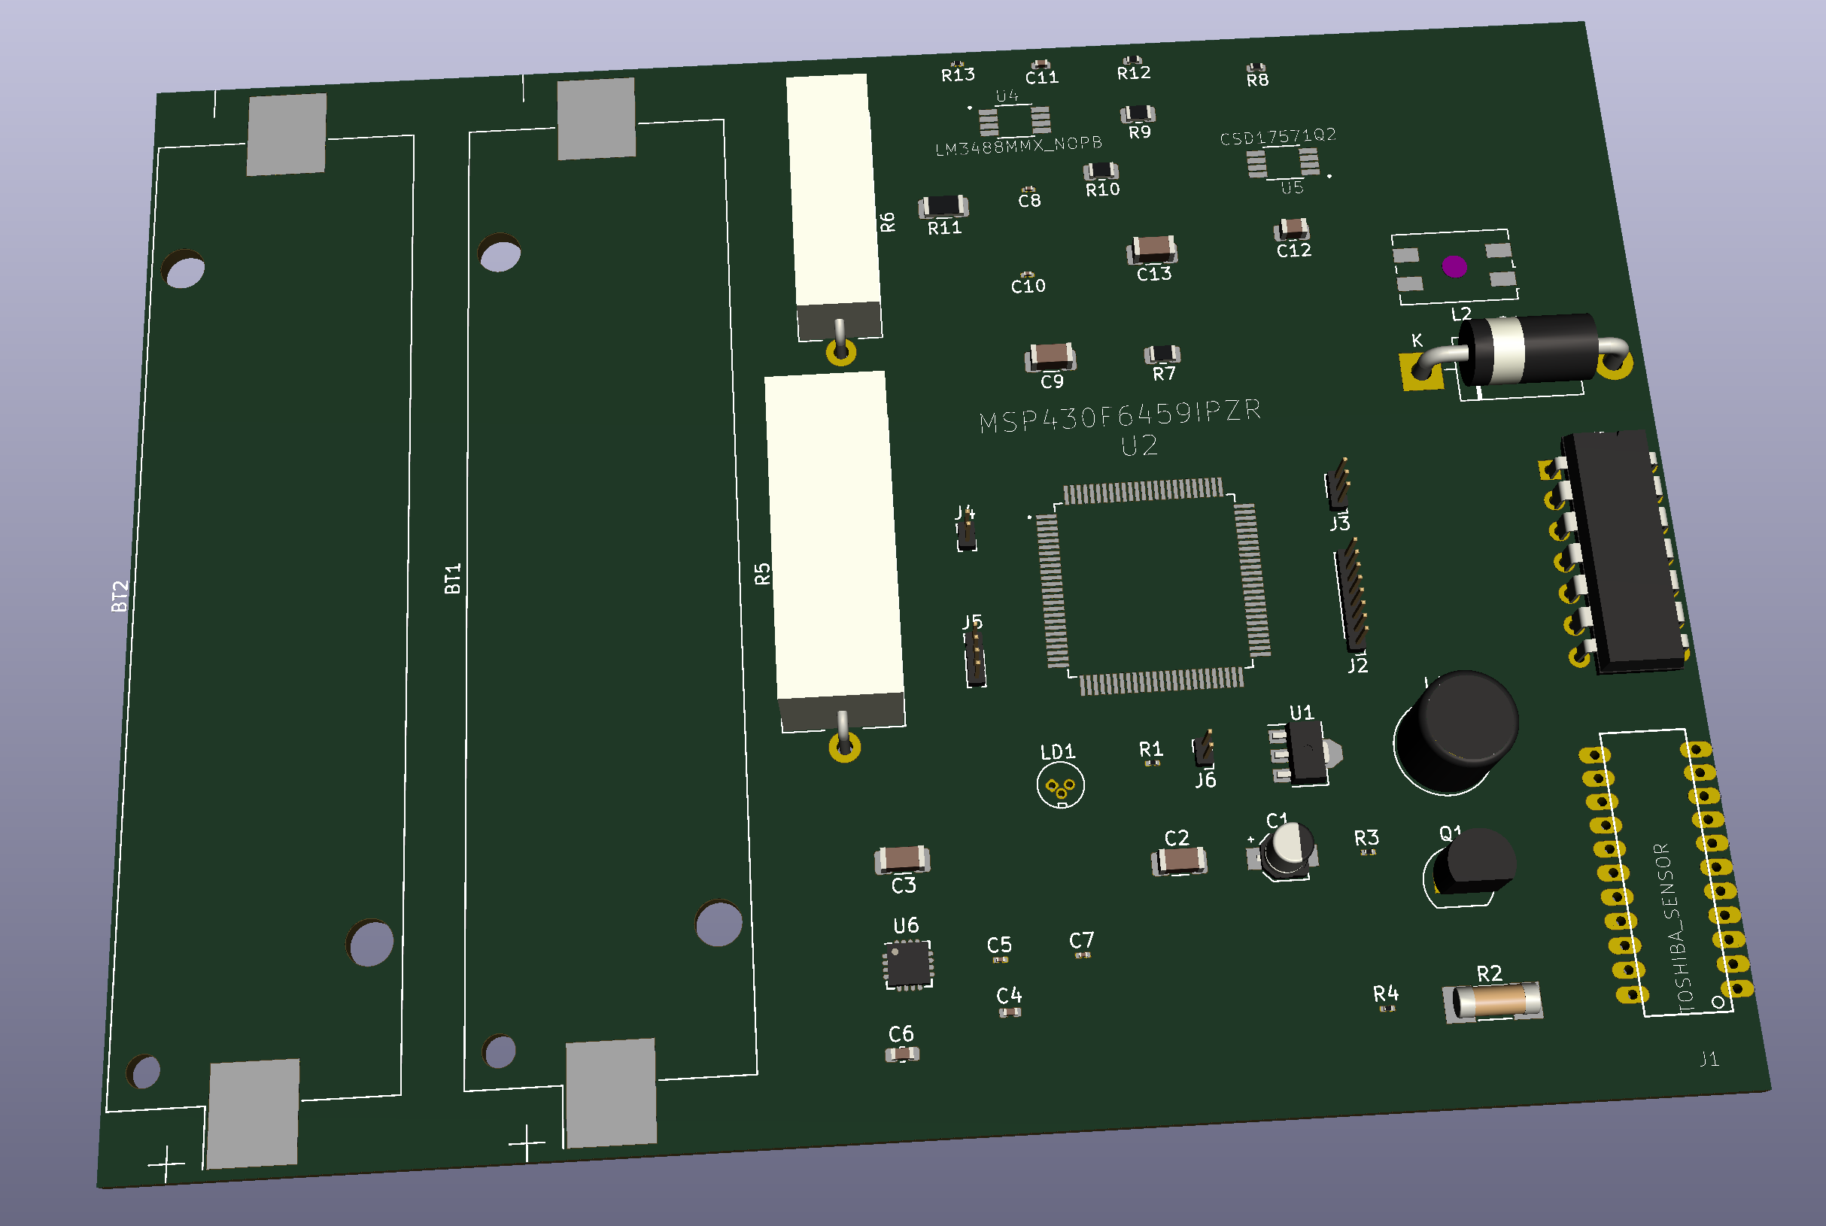
PCB

Slide 19
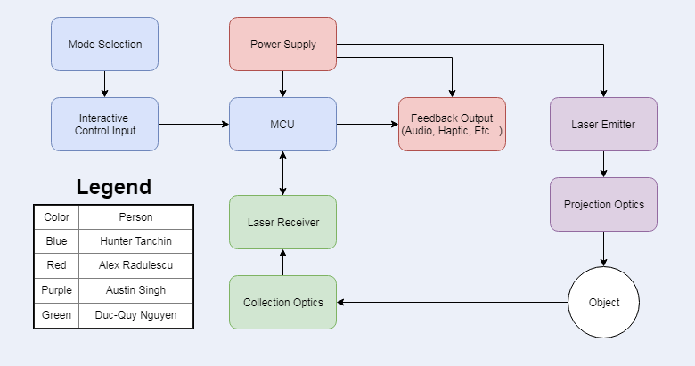
Overall Block Diagram
Notes:
Block Diagram

Slide 20
Bill of Materials
Item # | Name | Manufacturer | Price | Quantity | Total
1 | Laser Diode (L904P010) | Thorlabs | $26.01 | 1 | $26.01
2 | Bandpass Filter (FL905-10) | Thorlabs | $95.88 | 1 | $95.88
3 | Cylindrical Lens | Thorlabs | $56.10 | 1 | $56.10
4 | Plano-Convex Lens (LA1540-B-ML) | Thorlabs | $38.16 | 1 | $38.16
5 | MSP430F6459 | TI | $43.95 | 1 | $43.95
6 | DRV2605 haptics driver | TI | $11.65 | 1 | $11.65
7 | 1304DG Image Sensor | Toshiba | $5.10 | 1 | $5.10
8 | 74HC04D Hex Inverter | Arrow | $0.65 | 1 | $0.65
9 | 2SA1015 Transistor | Arrow | $0.65 | 1 | $0.65
10 | PCB | 4PCB | $33 | 1 | $33
 |  |  |  | Final Price | $311.15
Notes:
Show BOM with team
Quy
Estimated vs Actual
Final Model Price

Slide 21
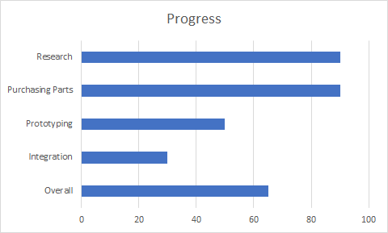
Administrative Content
Notes:
Show Charts with team what category want to add

Slide 22
What’s Next?
Design/Fabricate Test Housing
Integrate Haptic Feedback
Iterations of the PCB

Slide 23
Any Questions?

